Slide 1
Our Sustainability Journey …so far
Retrofitting Community Buildings
Chris Warwick (project lead) & Debbie Greenfield (Chair) The Harwellian Club

Slide 2
A bit about us…
Not-for-profit sports & social club becoming a social hub for the village
Voluntary committee
1980s building with poor insulation, heating and hot water from old gas boilers
High electrical demand - 24 hours a day due to chillers
BUT:
Large south facing slightly sloping roof!
Before

Slide 3
Motivation – save money and the planet
Old utility costs (16.8p/kWh) £370/month (£4,400/year)
New expense rising to £1,250/month (£14,800/year)
Started with an Energy Survey
Spoke to the Low Carbon Hub – March 2022
Free energy audit by the Environmental Information Exchange (EiE) at Oxford Brookes University
Survey funded by a grant made by the community energy co-operative Westmill Solar
Survey carried out by Michael Esvelt, July 2022
Report received August 2022

Slide 4
Then started applying for grants
Fund | Focus | Max available | Awarded
National Lottery Community Fund | Community e.g.” improve the places and spaces that matter to communities” | £10k More available via other schemes | £10k
Westmill Solar Community Grant | Community benefit projects plus climate change aims Must be within 25 miles of the Westmill site | £5k | £5k
OCC Climate Action Fund | Climate change awareness and education | £5k | £5k
Low Carbon Hub |  |  | £2.5k
So, received total of £22.5k towards the total project costs of ~£39k.
Remainder paid out of operating funds.
Even a loan would have been justified based on the predicted savings.

Slide 5
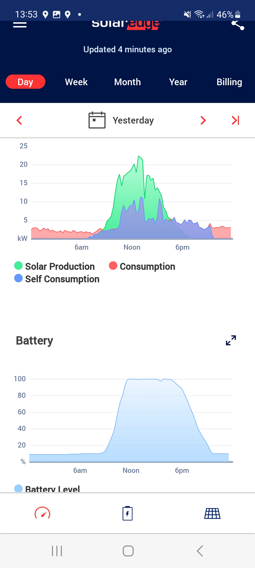
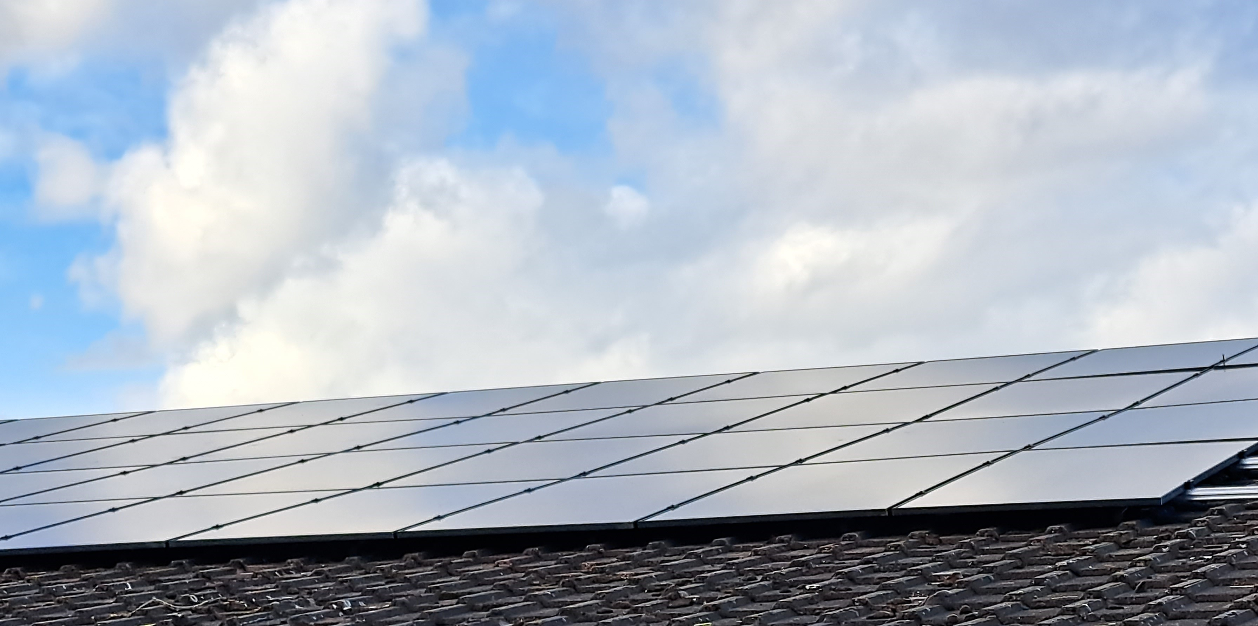
Implementation – phase 1 Solar Panels
68 x 400W solar panels + 2x10 kWh batteries
Order placed September 2022
6-month lead-time
Installation March 2023

Slide 6
Implementation – phase 2 Heat Pumps & Education/Engagement
Heat Pumps:
Replacing out aging gas central heating with air-source heat pumps
Work underway this week, completion this month
Education/Engagement:
Publicity via the Club’s newsletter and the Harwell News
Working with Sustainable Harwell
Referrals to Harwell Village Hall and Chilton Village Hall
Harwell School and Little Pippins Pre-school
Planning additional information points within the club to show real-time and historic energy data and savings
This meeting

Slide 7
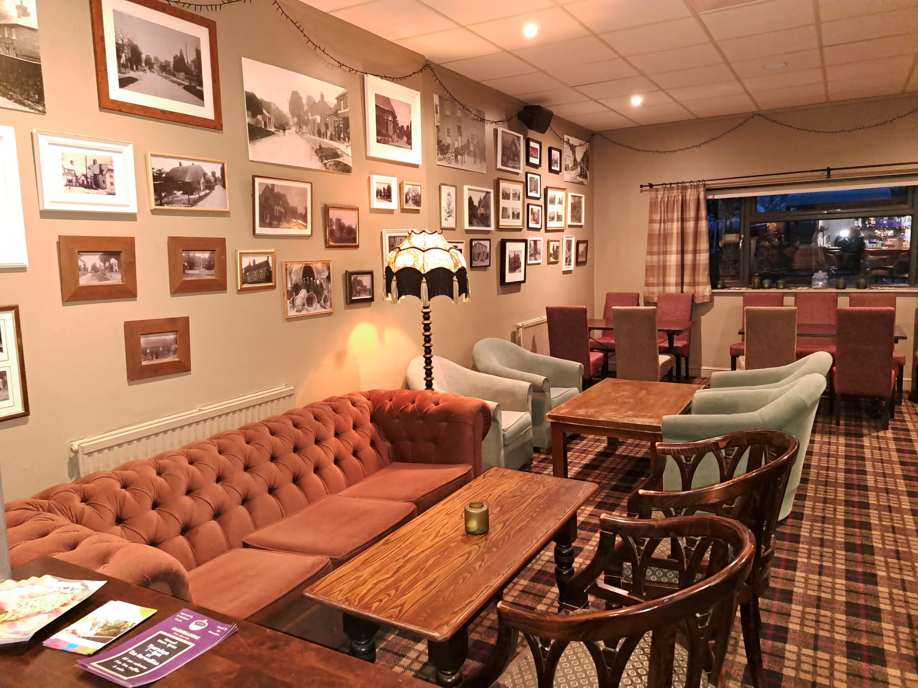
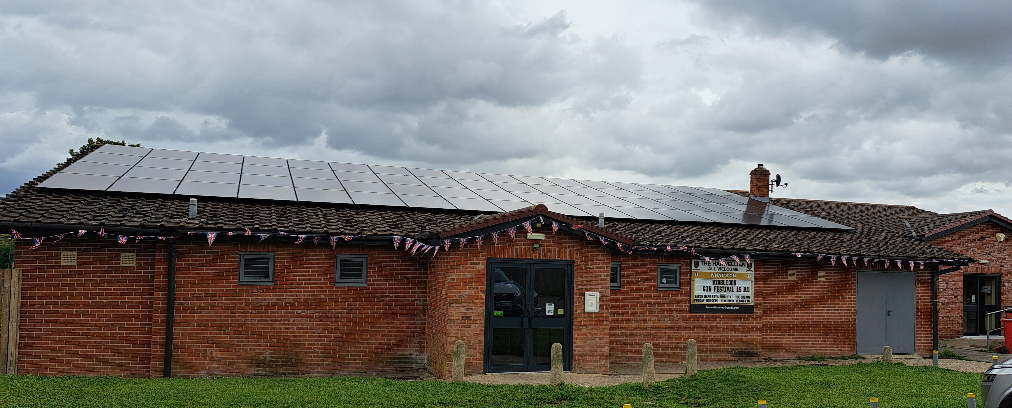
Harwellian Futures
Plan - remove our fossil gas supply:
Already converted water heating from gas to instantaneous electric
Electric cooking
New heating/cooling system means gas will no longer be required
Other things:
More batteries
Revisit other recommendations from the energy survey
More insulation!
After

