Slide 1
Energy efficiency measures

Slide 2
Sports Park Background
Originally formed in 1972 from 5 existing clubs
WST is umbrella organisation - CIO with WSSC wholly owned as limited company to run bar/kitchen etc
Site leased from SODC on 35 year lease
Home to 8 autonomous sports clubs and local community centre for 20+ weekday daytime groups and weekend evening social activities
Volunteer culture with all improvements grant funded

Slide 3
Recent Energy History
First energy audit in 2010 led to:
loft and wall insulation
double glazing
centrally operated zonal heating controls and partition to close off main hall when not in use
Subsequent improvements all to modern standards including
new gas -fired hot water and central heating system
upgrading external floodlighting to AWP and football stadium pitch to most efficient pre-LED lights,
replacing virtually all internal light fittings with LEDs
automatic closing system to front doors,
Started developing solar system in 2019, shelved because
no grant funding available,
Covid

Slide 4
Energy Crisis
2021/22 electricity consumption 150,000 kWh, of which;
65,000 in pavilion
60,000 on AWP
24,000 other external
Fixed price contract at 14p per kWh ended July 2022
Over 100p in September, 57p with Government support over winter
New free energy survey by Brookes University via Low carbon Hub, June 2022 key to accessing grants
Survey recommendations;
- management measures in pavilion – done Autumn 2022 (own funds)
- convert AWP lights to LED – done January 2023 (S106 grant)
- install solar/battery system on pavilion roofs – outstanding
Current consumption rate down to 100,000kWh pa

Slide 5
Wallingford Sports Park
SUMMARY PV SOLAR PROPOSALS
 | No panels X output | Installation kWp | Generation kWh / year | Battery kWh | kWh used on site | kWh/ kWp | Ex VAT £ | 5% VAT £ | TOTAL £ | Cost / kWp £ | Carbon save tonnes
Jo Ju | 132x380w | 50.16 | 43,733 | 33.00 | - | 872 | 73,431.74 | 3,671.59 | 77,103.33 | 1,537.15 | 11.18
Next Generation | 126x380w | 47.88 | 45,965 | - | 28,130 | 960 | 93,000.00 | 4,650.00 | 97,650.00 | 2,039.47 | 24.04
IDDEA | 40x400w | 16.00 | 15,728 | 23.20 | 15,413 | 983 | 37,900.00 | 1,895.00 | 39,795.00 | 2,487.19 | 3.13
Energy My Way | 130x415w | 53.95 | 50,012 | 46.40 | 37,008 | 927 | 73,980.43 | 3,699.02 | 77,679.45 | 1,439.84 | 27.02
1st March 2023
 | Payment | Guarantee Panels | Guarantee Battery | Guarantee Inverter | Guarantee Workmanship | Monitoring | Maintenance
Jo Ju | 60% 14 days prior Installation 40% 7 days post | 25 year 97.5% output | 10 year | 5 year | - | - | -
Energy My Way | 25% with order + stage payments | 30year 85.05% output | 10 year | 5 year | 2 year | portal via smart phone app | -
13th March 2023 Adrian Aldred

Slide 6
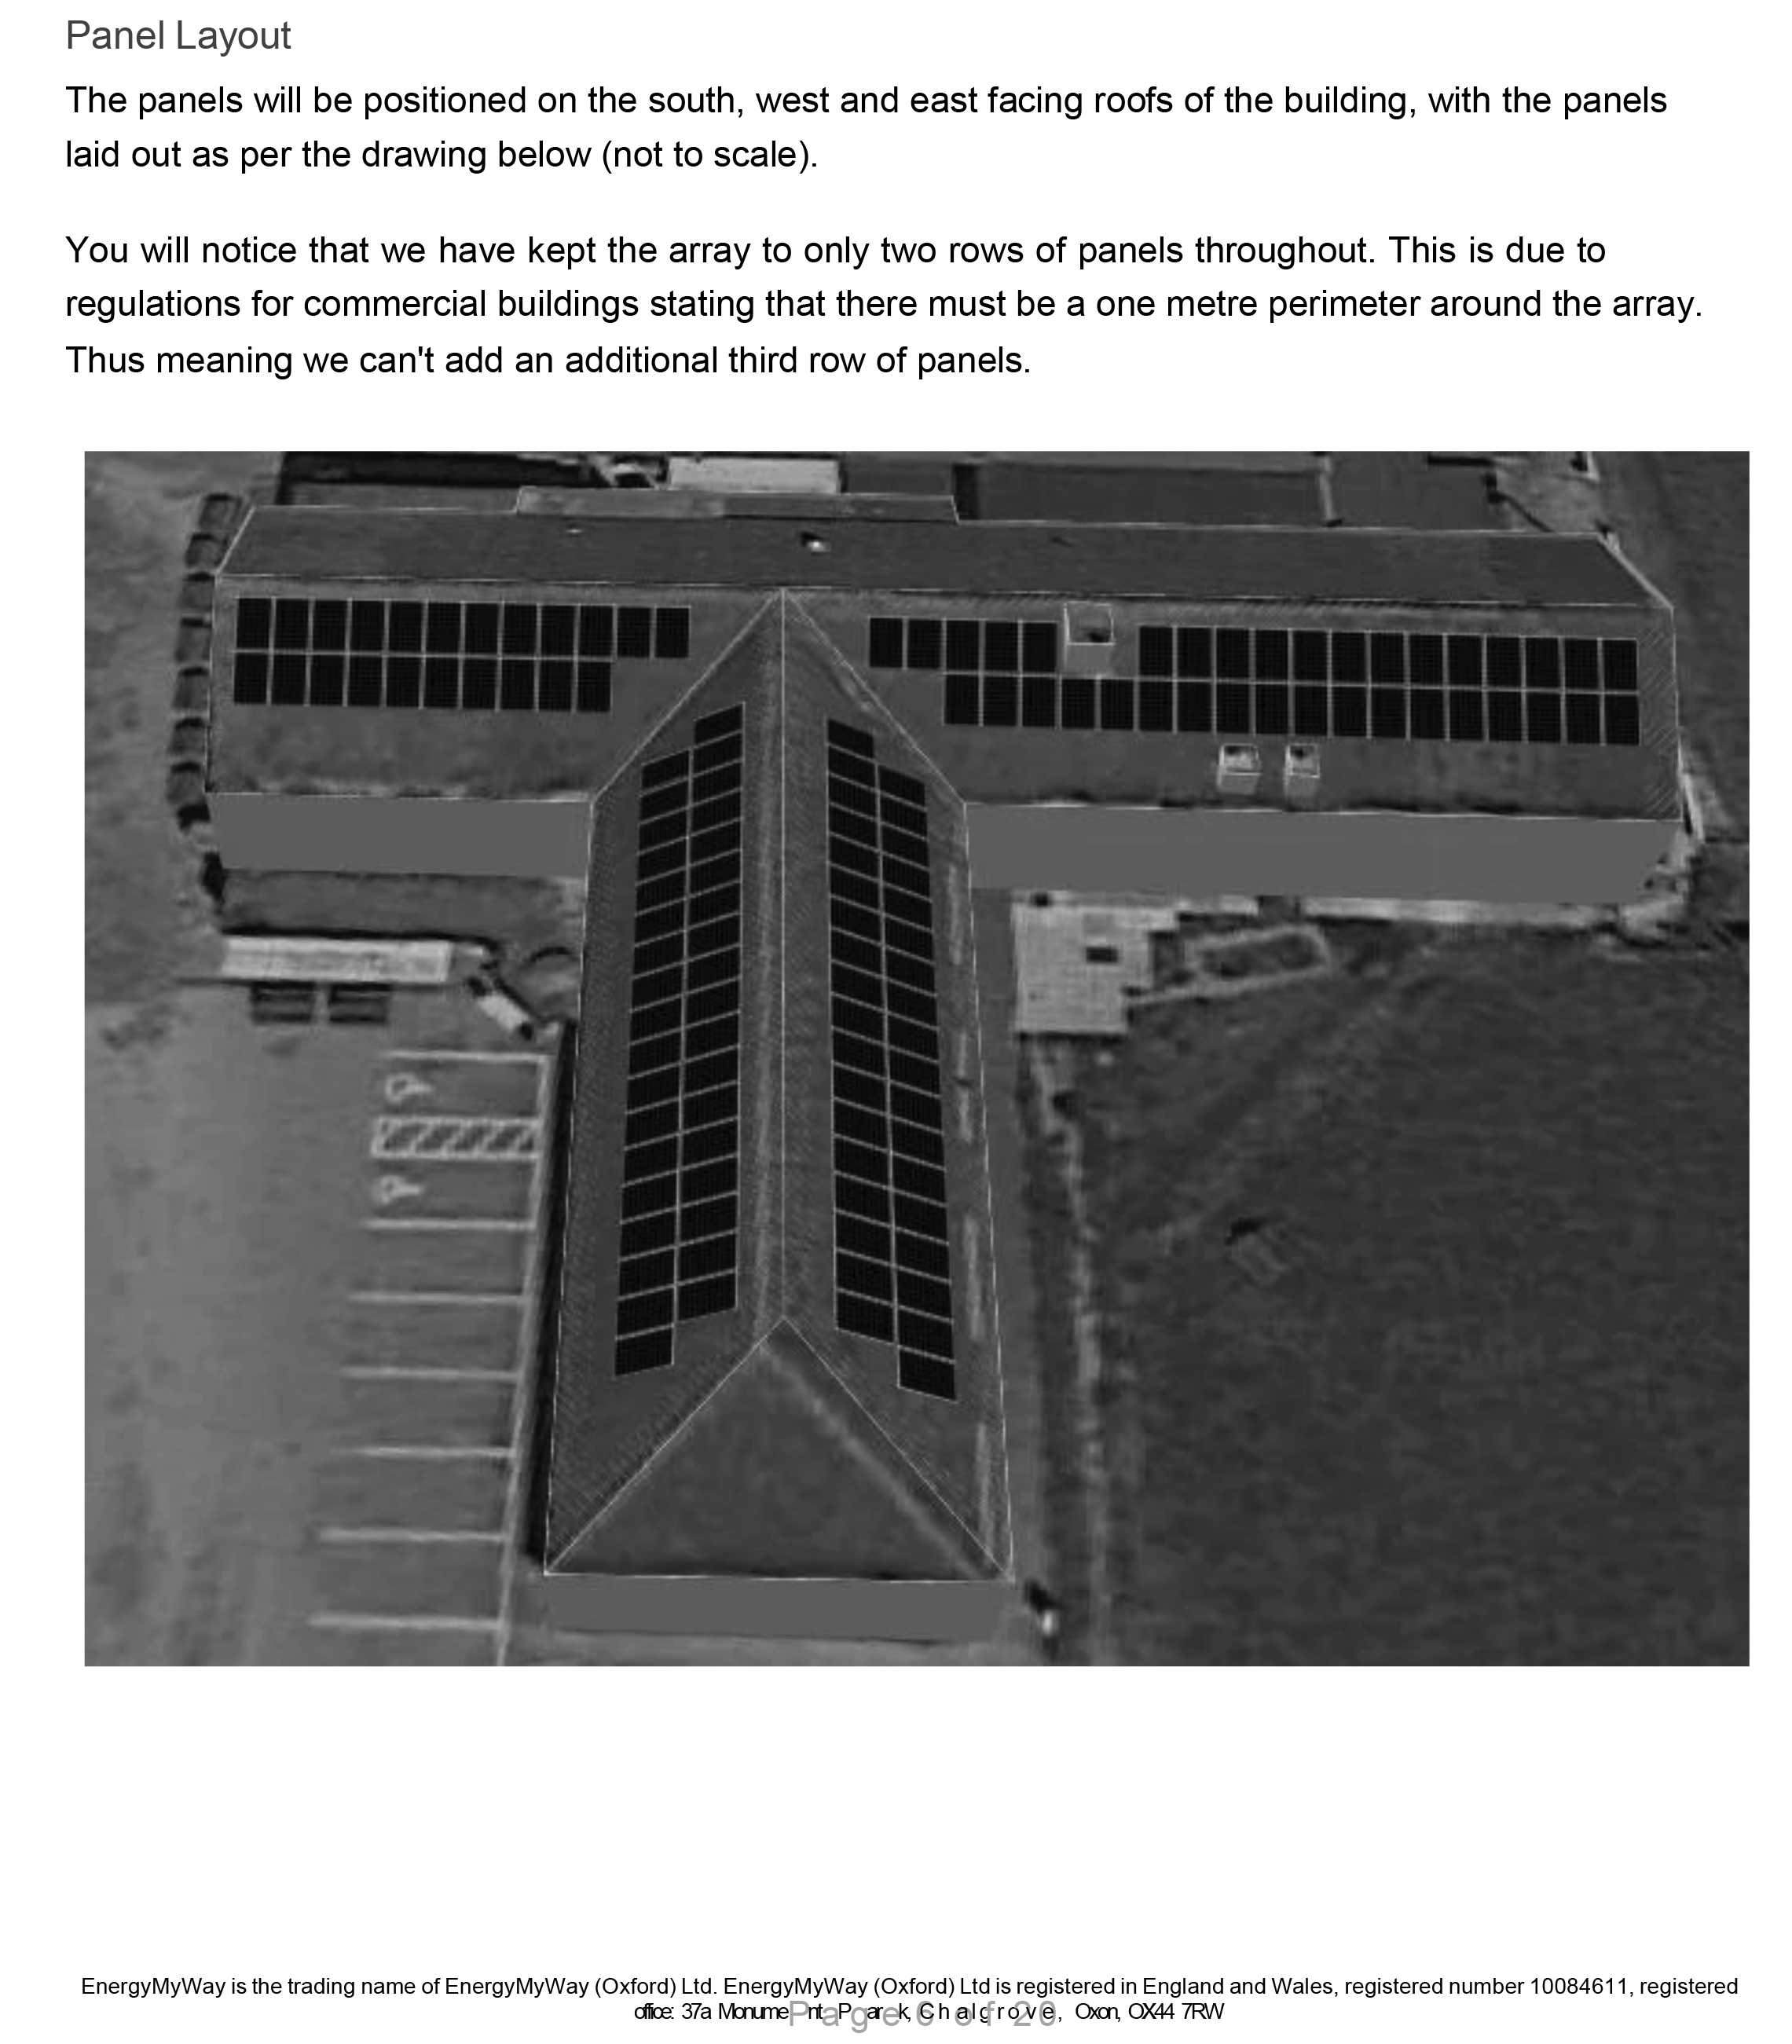

Slide 7
Solar/battery project
4 realistic proposals received of which Energy My Way highest for kWh use on site and lowest for cost per kWh
Installation of 130 panels on east, south and west facing roofs generating 50,000 kWh pa - with 4 no 11.6kWh batteries will produce 35,000 used on site
Cost £80,000 - funded by
- Big Lottery £10,000
- Westmill Solar £5,000
- Cranford House School £10,000
- SODC £41,000
- Fugro £2,000
Outstanding issues
- £12,000 CIL bid
- SODC license
- G99 approval
Anticipated start date – mid September
Further investigation – maximise use of lost 15,000 kwh pa to heat existing gas-fired boilers

