Slide 1
















Jessie Fieth
Senior Climate Action Officer
South Oxfordshire and Vale of White Horse District Council

Slide 2
Agenda for this evening
18:00 Welcome
Dominic Lamb, Climate and Biodiversity Team Leader, South Oxfordshire and Vale of White Horse District Councils
18:05 Support from the district councils
Jessie Fieth, Senior Climate Action Officer, South Oxfordshire and Vale of White Horse District Councils
18:15 Renewable energy and community buildings
Michael Elsvelt, Environmental Information Exchange, Oxford Brookes University
18:25 Case study: Retrofitting the Wallingford Sports Trust building
John Atkins, Co-Chairman, Wallingford Sports Trust
18:35 Case study: Installing solar panels at the Harwellian Club
Debbie Greenfield and Chris Warwick, Harwellian Club Executive Committee
18:45 Q&A
19:00 End

Slide 3
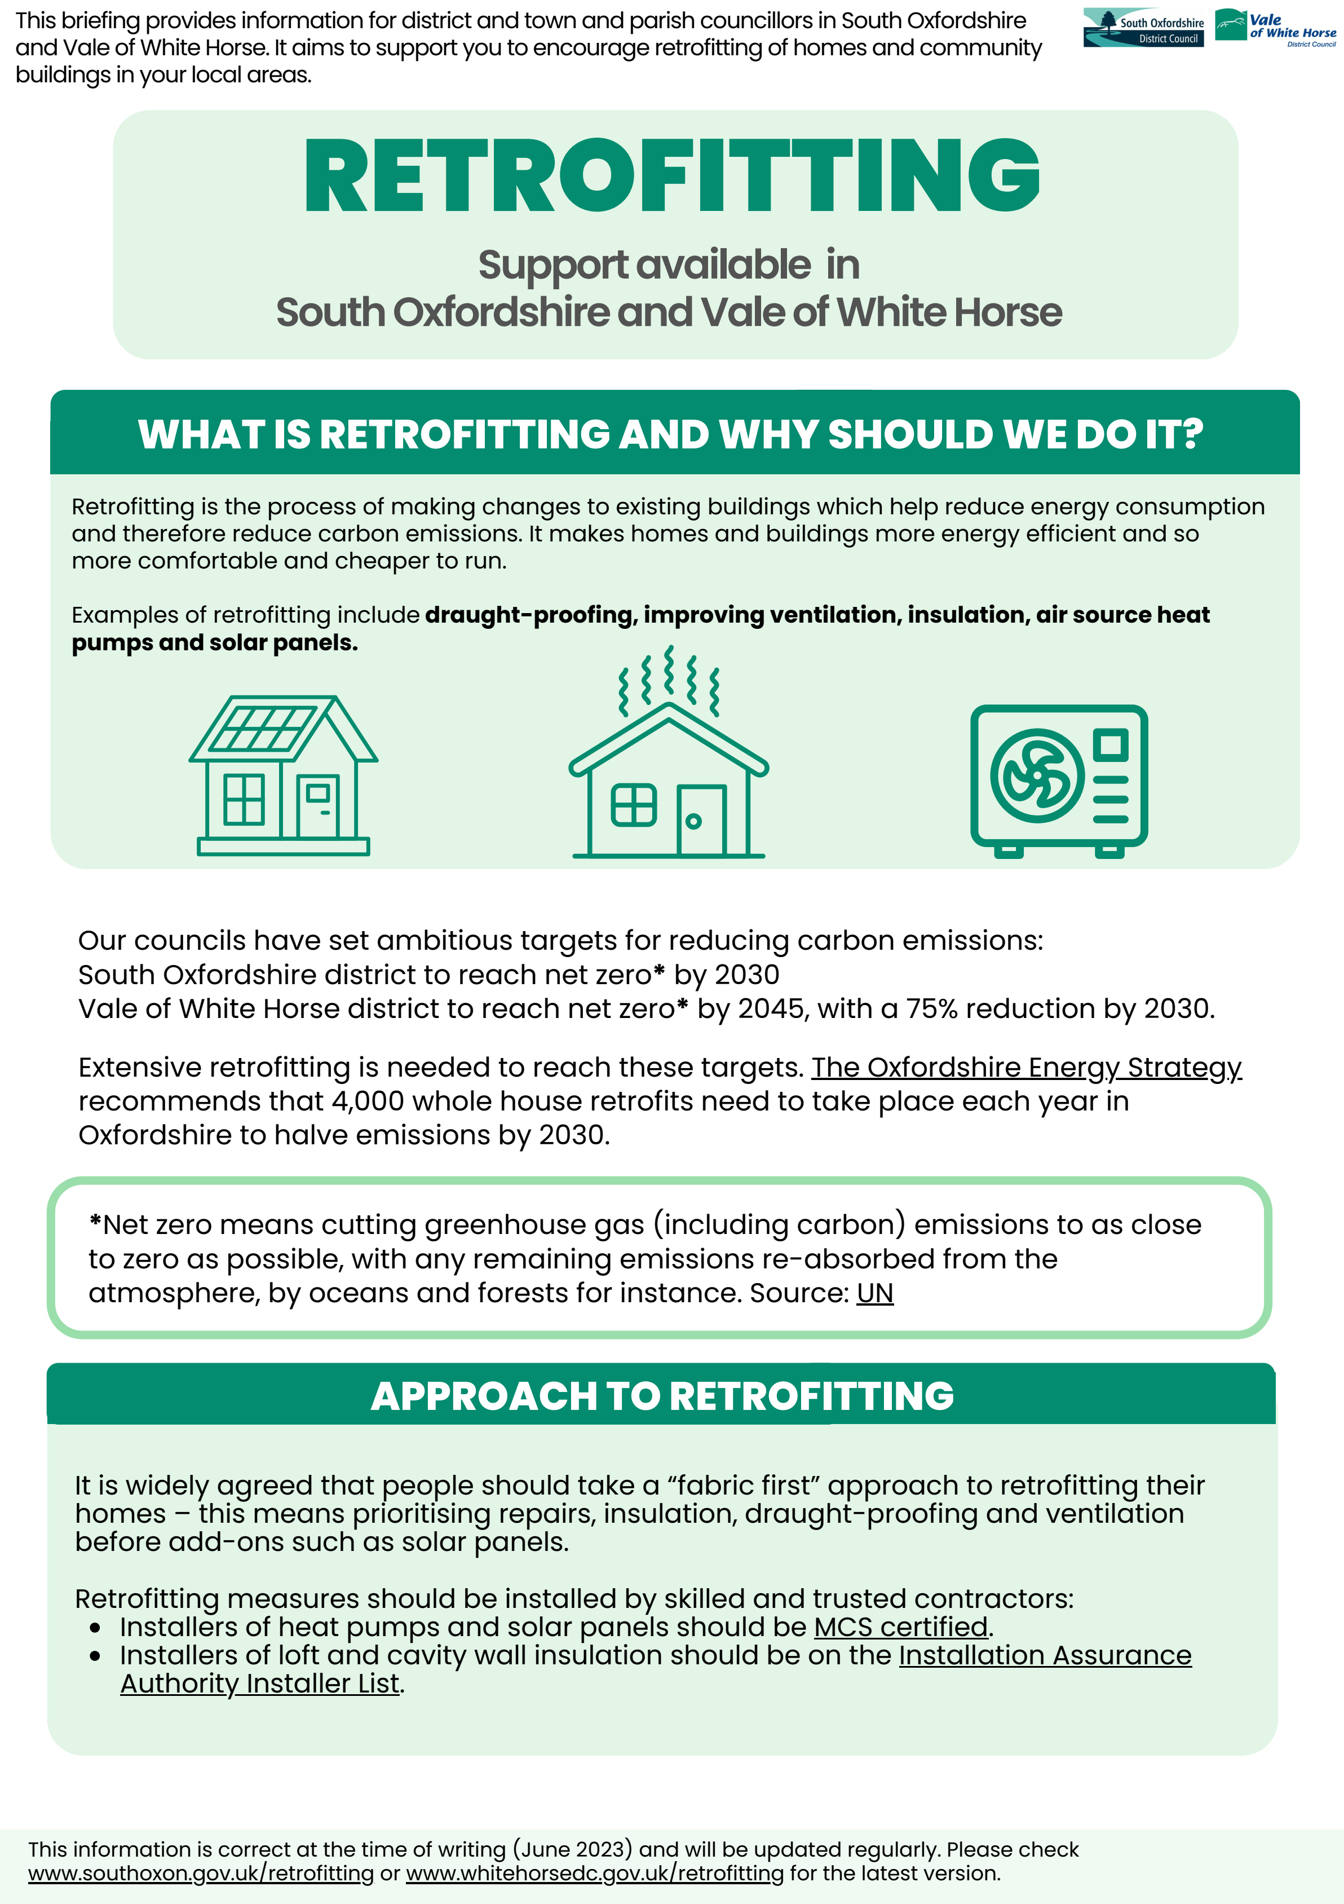
New briefing document
Provides information on retrofitting support, advice and funding available
To help councils and groups to help residents in your areas

Slide 4
Sources of information and support
Information on the district council websites (South Oxfordshire and Vale of White Horse)
Energy Solutions Oxfordshire supports businesses and community groups in Oxfordshire to save energy in their buildings.
Community First Oxfordshire’s Community Hall Affiliation Scheme offers advice to community halls on a wide range of topics including refurbishment and energy efficiency.
Low Carbon Hub’s Community Building Checklist offers tips and resources.

Slide 5
Carbon emissions calculator
For town & parish councils
Calculates annual carbon emissions of organisation
Source of carbon emissions are likely to be:
Lighting and heating for buildings
Mowing equipment
Pool cars
Use information from energy bills and fuel receipts
Suggest completing at end of each financial year
Contact: climateaction@southandvale.gov.uk

Slide 6
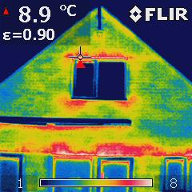
Loaning thermal cameras
Town & Parish Councils and community groups can borrow a thermal imaging camera from the district council.
Thermal imaging cameras can visually show where heat is leaking out of buildings.
October to March only
Contact: climateaction@southandvale.gov.uk

Slide 7
Electric Vehicles (EVs)
The Government’s The Road to Zero strategy restricts the sale of fossil-fuelled cars from 2030.
Adding a EV charge point at a community building would provide valuable community service, opens up charging opportunities to those without off-street parking.
EV Car Clubs – community buildings could be a host/enabler. Collaborative Mobility UK (CoMoUK) has published guidance on setting up community car club.
For information about planning permission for EV chargers, please visit the Planning Portal webpage on electric vehicle charging.
Opportunities
Oxfordshire Local Electric Vehicle Infrastructure (LEVI) Government funding – future plans to support installation of EV chargers in communities. To register interest for your site, please email climateaction@southandvale.gov.uk.
Government Workplace Charging Scheme - provides support towards the upfront costs of the purchase and installation of EV chargepoints. Chargepoints must be for staff or fleet, however you can allow local residents to use the chargepoints outside of office hours. The guidance for applicants provides further details.

Slide 8
Planning surgeries
The planning team holds monthly surgeries for members of town and parish councils to discuss general planning queries.
Next meetings:
South Oxfordshire - Friday 4th August
Vale of White Horse – Friday 18th August
You can book a 15-minute online meeting through this link.
If there are any questions, please contact Emily Hamerton: emily.hamerton@southandvale.gov.uk

Slide 9
Funding opportunities
S106/CIL funding (information for South Oxfordshire and Vale of White Horse)
District Council’s community grants
Vale of White Horse Climate Action Fund – closing Friday 14 July, midday
South Oxfordshire councillor community grant scheme – currently open
South Oxfordshire capital grant scheme – expected to open Sept 2023
Other grants e.g. Westmill Solar, Big Lottery, People’s Postcode Lottery and Rural Community Building Loan Fund

Slide 10
Do you lease your building?
Before getting started, check whether you own your community building.
If you lease it (even for a long time), you must check that the alterations/improvements you are proposing comply with the lease terms.
If you need to get the landlord’s consent, make sure you seek this as early as possible. You may need to have the improvements formally approved by way of a legal document (a licence).
If in any doubt, get in touch with your landlord.

