Slide 1



Energy efficiency in community buildings
(The trouble with)

Slide 2
Our work with communities
- Energy assessments of over 300 sites
- Feedback most recent 75 sites:
- 134.89 t of CO₂e potential savings per year
- 23.60 tonnes of CO₂e savings per year (24)
- Heating is 65% recommended savings

Slide 3
The community challenge
- Provide a flexible space for users
- Meet needs and expectations (comfort)
- Maintain the building for the future
- Attract users (consume more energy)
- Goal is improve efficiency per hour of use

Slide 4
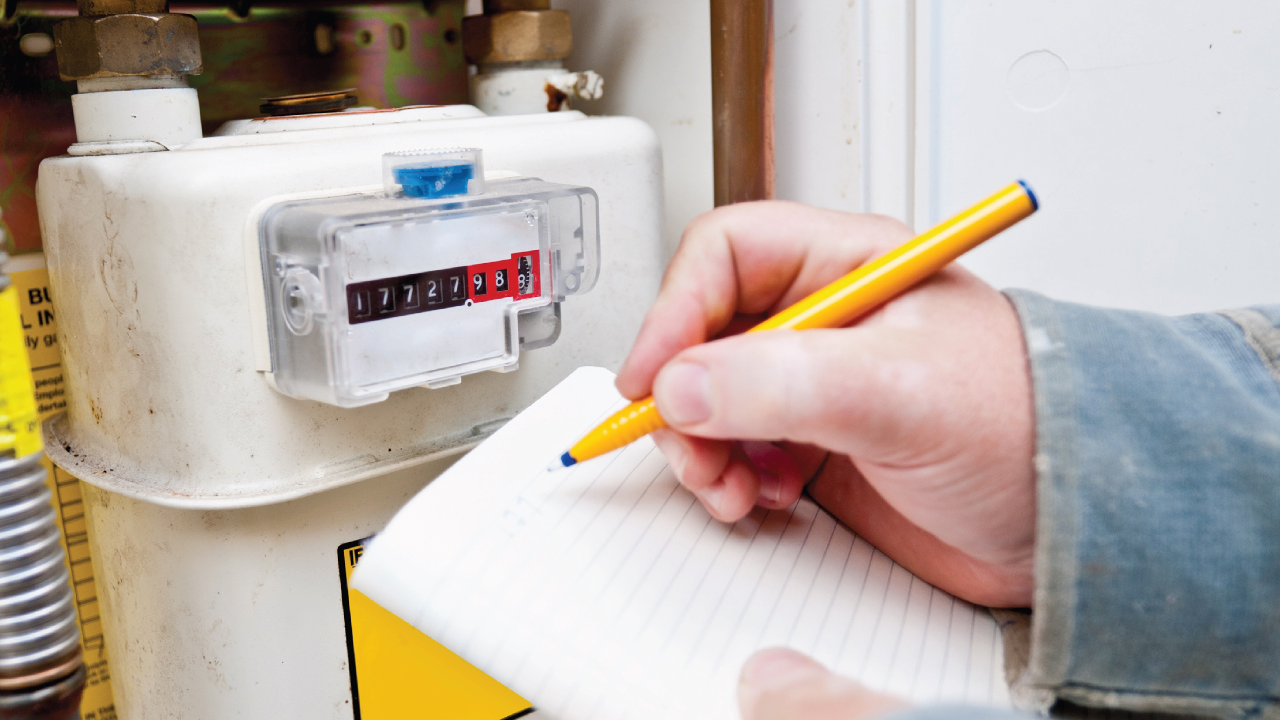
Energy monitoring

Slide 5
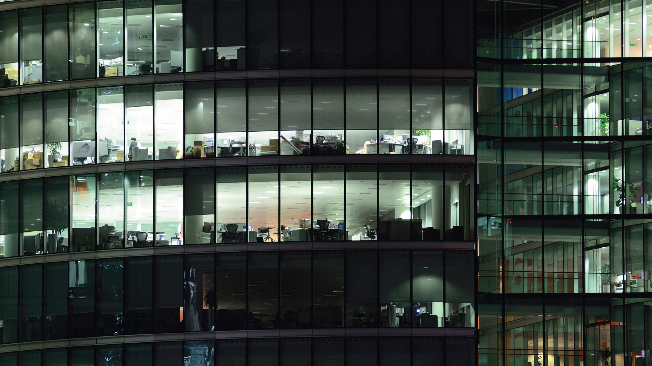
Where is energy wasted?

Slide 6
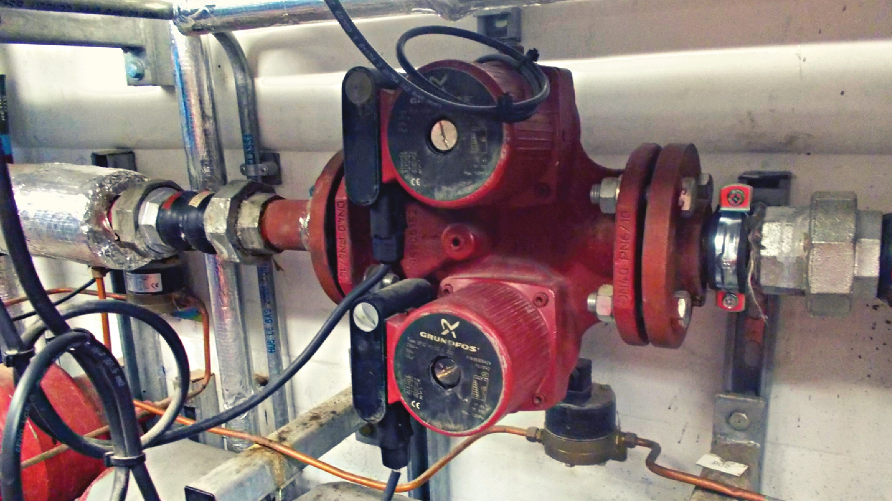
Range of issues

Slide 7
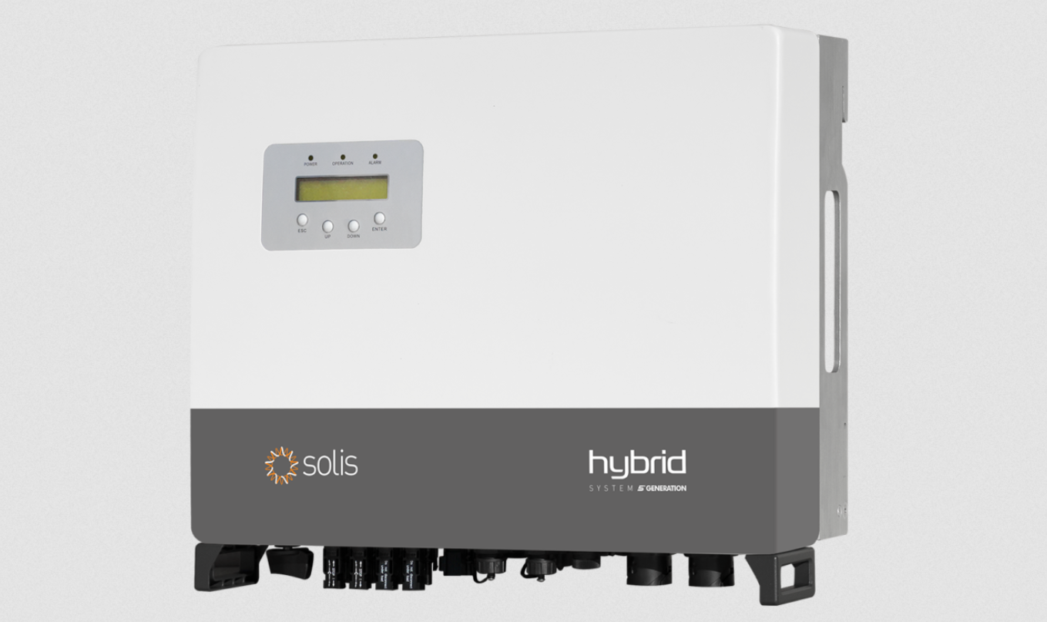
Future proof?

Slide 8
Holistic approach
- Funding opportunities
- Technical & contractor advice
- Follow up and updates
- Energy assessments are available
- Check the Low Carbon Hub website

