Slide 1
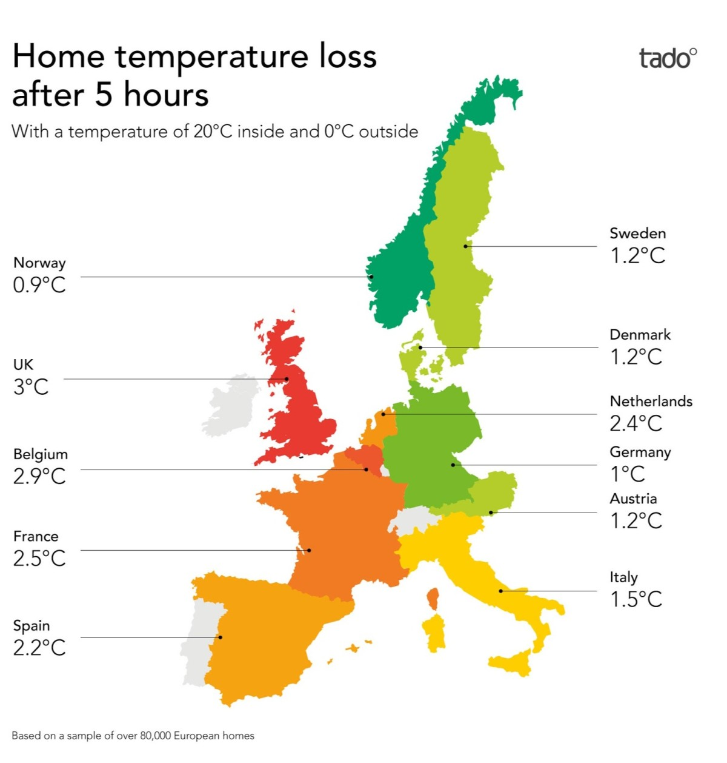
Why

Slide 2
The
Cosy Thame pilot
Winter of 2022/23

Slide 3
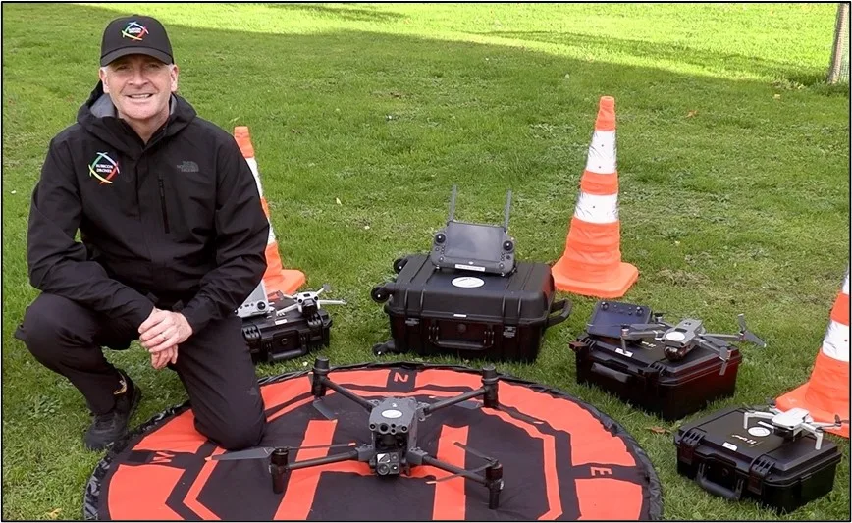
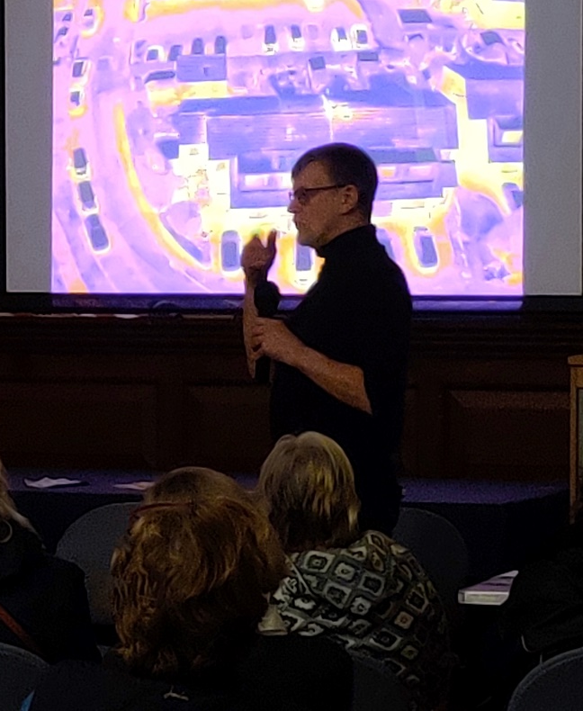
The Cosy Thame pilot

Slide 4
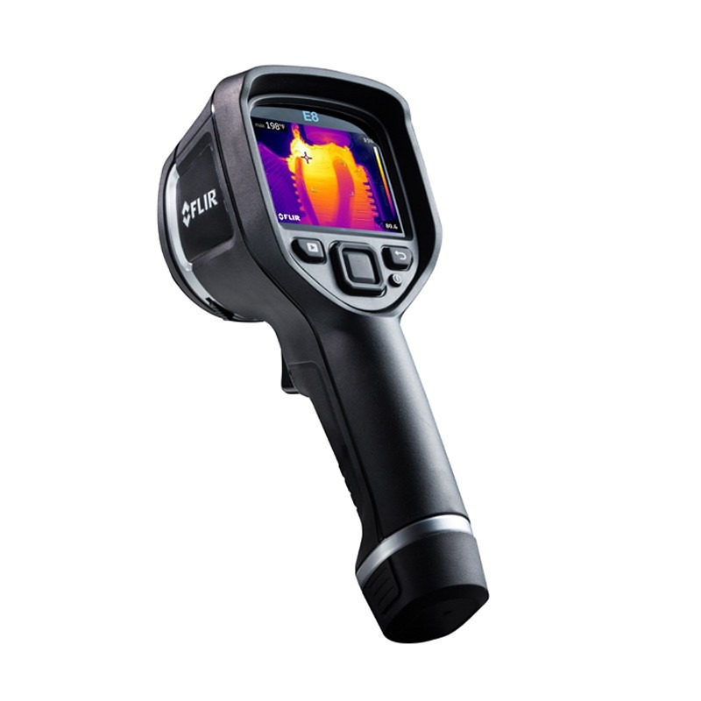
The Camera
Fleur E5 thermal imaging camera
£1,600

Slide 5
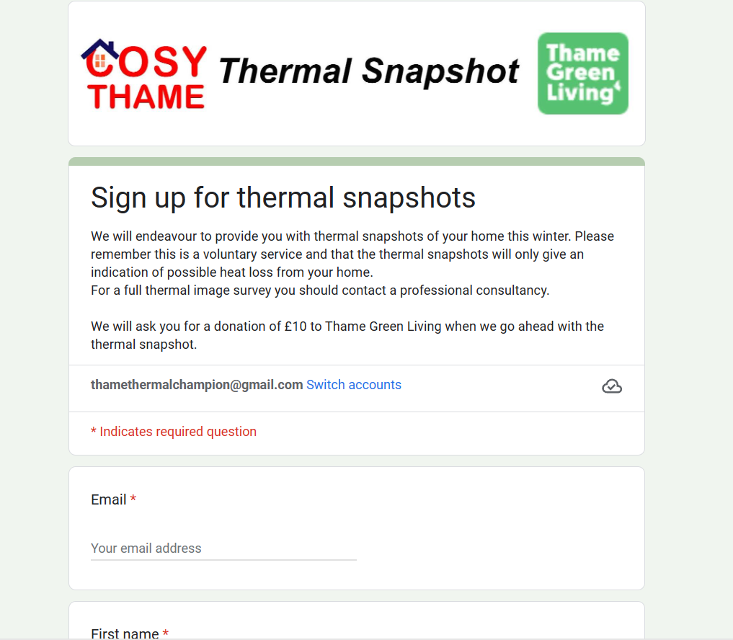
The sign ups

Slide 6
The sign ups
Thermal Imaging Champions
12 trained November
15 training December

Slide 7
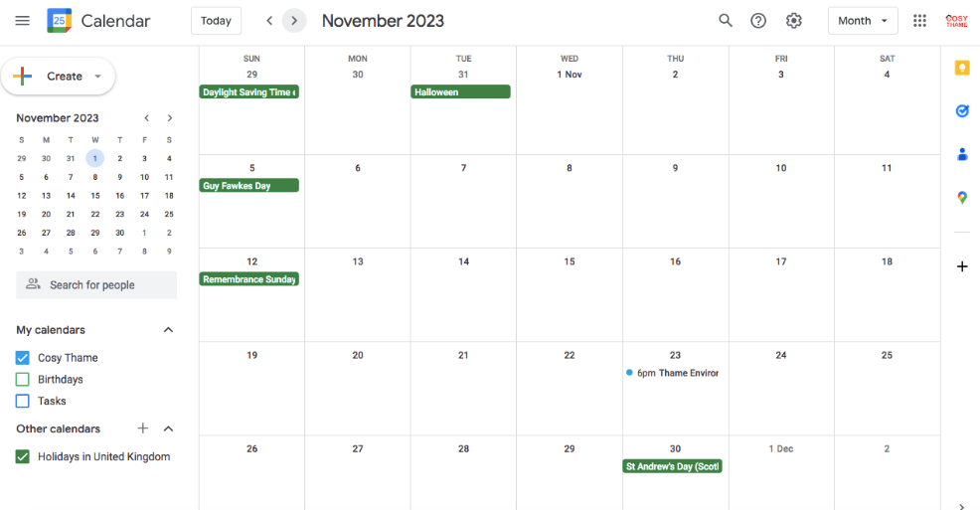
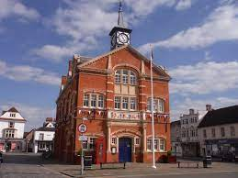
Booking the camera

