Slide 1
Jessie Fieth
Senior Climate Action Officer
South Oxfordshire and Vale of White Horse District Council

Slide 2
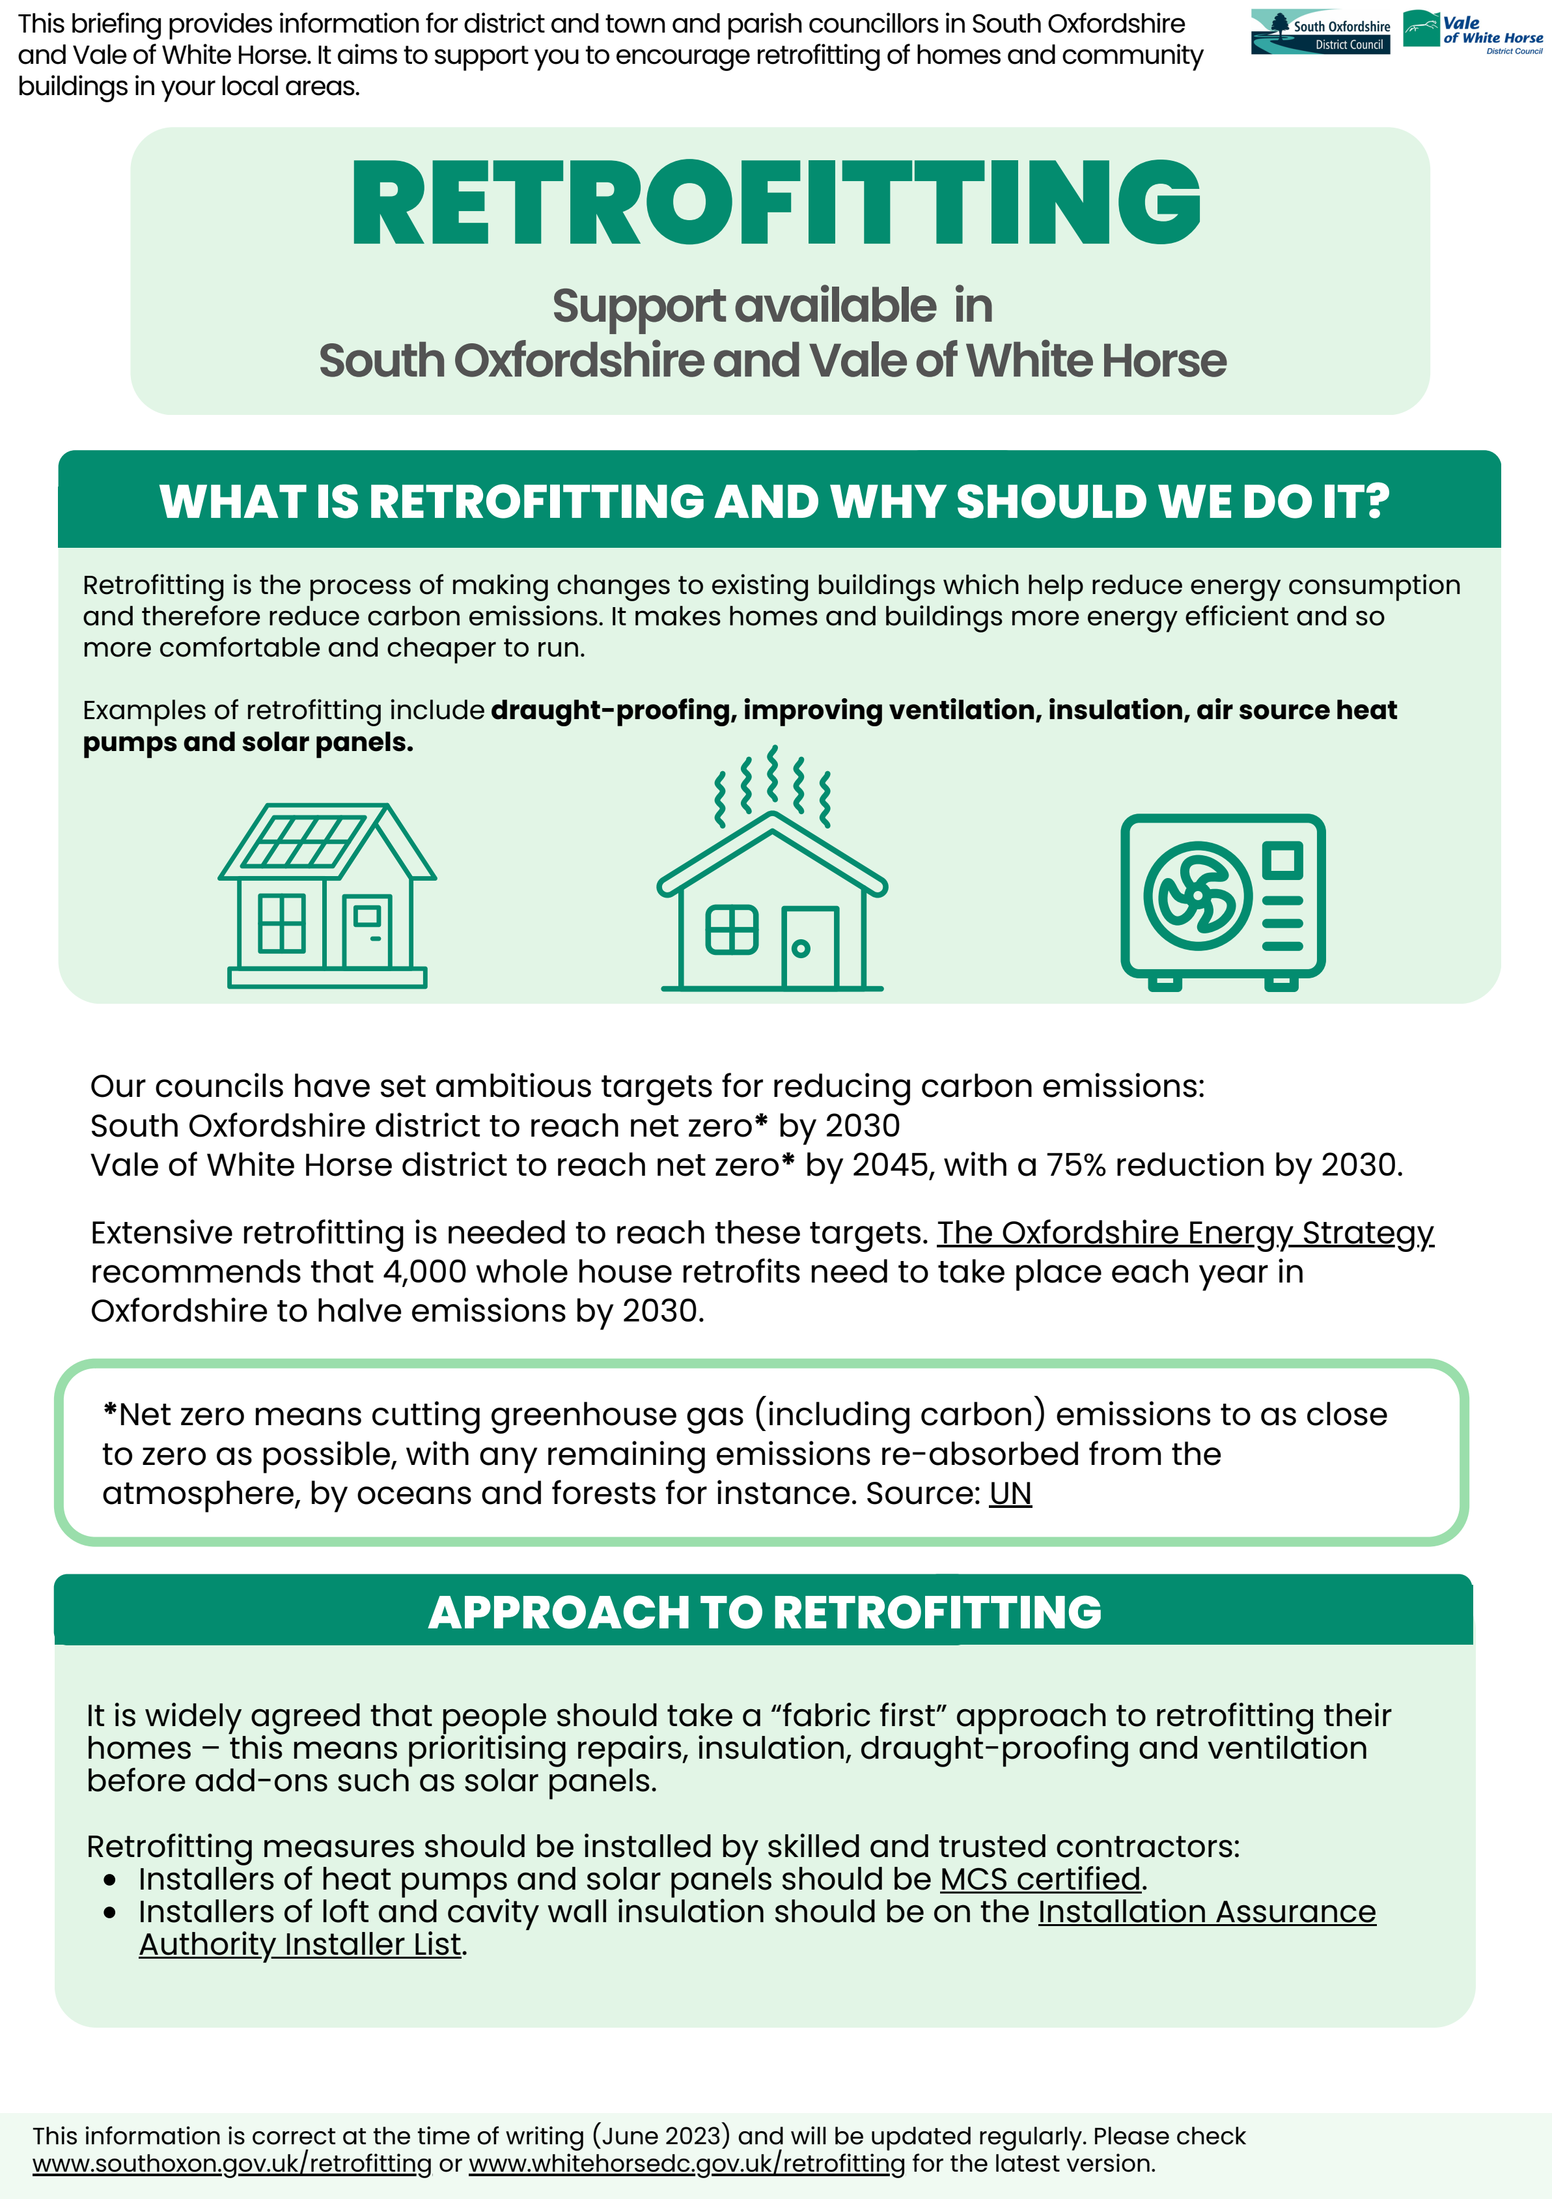
Sources of information
South Oxfordshire and Vale of White Horse district council’s retrofitting webpages
CSE’s community retrofit webpage
Better Housing Better Health
Cosy Homes Oxfordshire

Slide 3
Funding available
Grants for residents:
Home Upgrade Grant
Boiler Upgrade Scheme
Others available via Better Housing Better Health (ECO4 funding, Fuel Poverty Grant, Warm Homes Grant)
For supporting organisations:
Food and Warmth grant scheme (link for South Oxfordshire, link for Vale of White Horse) – closes 27 November
Climate Action Fund – currently closed, will reopen in 2024 [Vale of White Horse only]
Councillor Community Grant Scheme – closes 1 December [South Oxfordshire only]
Please keep an eye on the district council websites for updates - South Oxfordshire and Vale of White Horse.
Notes:
.

Slide 4
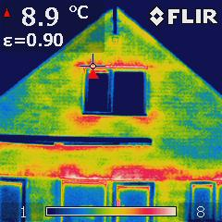
Loaning thermal cameras
Town & Parish Councils and community groups can borrow a thermal imaging camera from the district council.
Thermal imaging cameras can visually show where heat is leaking out of buildings.
October to March only
Contact: climateaction@southandvale.gov.uk

