Slide 1
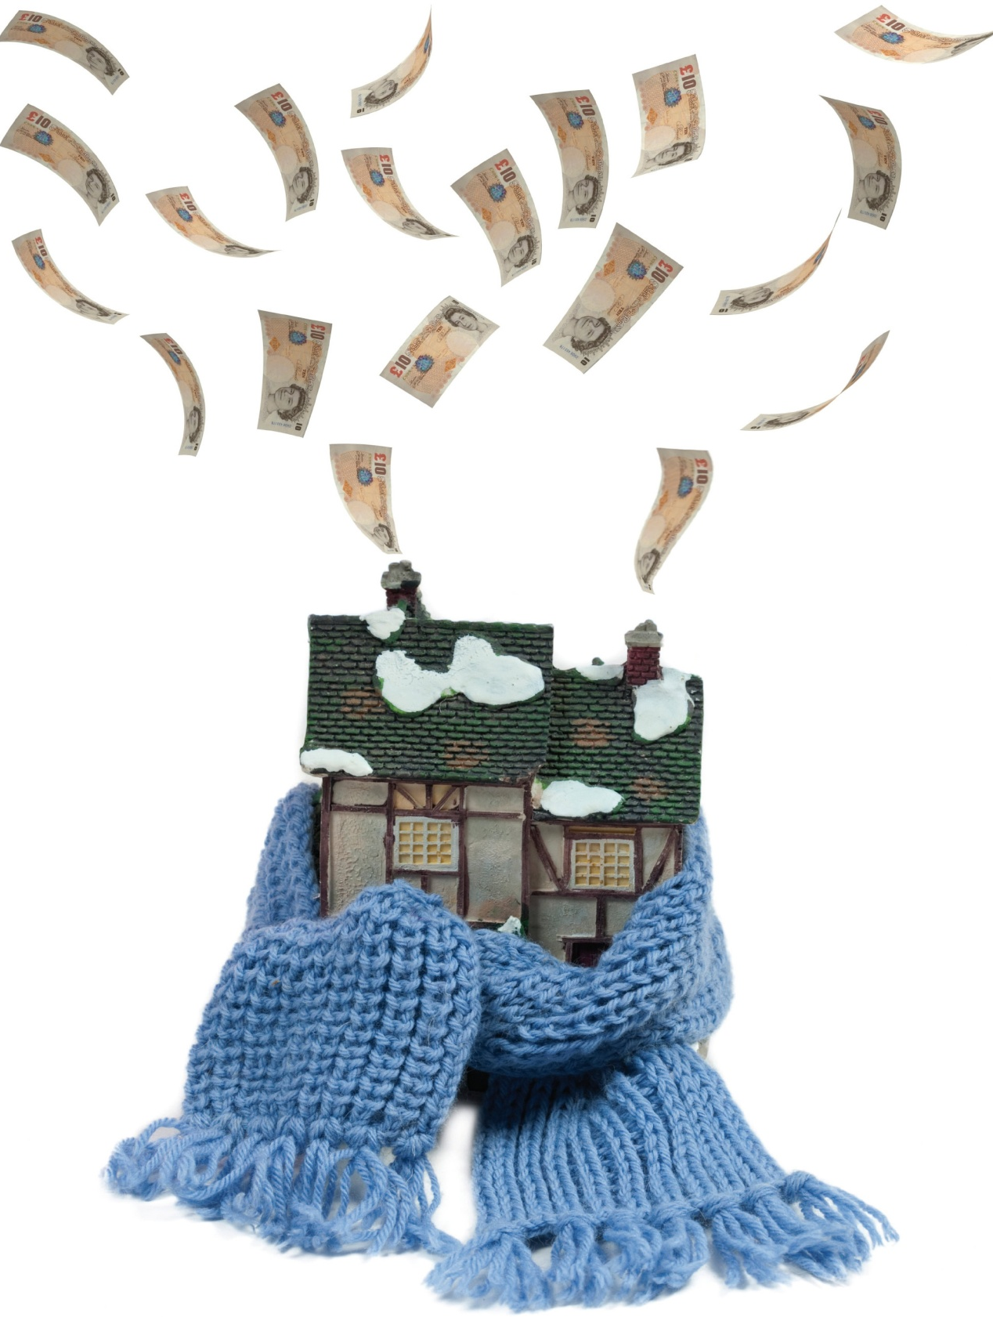
~ Supporting energy efficiency upgrades~
Tuesday,
14th November 2023
Dale Hoyland
Oxfordshire Retrofit Team Lead
Notes:
1

Slide 2
Current position
Facing a climate and ecological emergency
Cost of living crisis (fuel poverty increasing)
2019 7.4% in Oxfordshire (20,746 properties)
2020 8.2% in Oxfordshire (22,861 properties)
2021 8.4% in Oxfordshire (23,109 properties)
Two thirds of which live in rural areas…
… However, Oxford City remains significantly worse than the regional average
2022 figures?
2023 figures??
Notes:
A household is considered to be fuel poor if: (a) they have a fuel poverty energy efficiency rating (FPEER) of band D or below; and (b) if they were to spend their modelled energy costs, they would be left with a residual income below the official poverty line.

Slide 3
FUNDING

Slide 4
HUG2 in Oxfordshire
£6.4m to upgrade 310 properties
4 District Councils (exc. Oxford City)
Runs until 31 March 2025
Works delivered via delivery partner (AgilityEco / Welcome the Warmth) & subcontractors
Up to £38k worth of measures per property
Measures include insulation, ASHP & Solar PV

Slide 5
Dual-Branded Marketing

Slide 6
Eligibility
Owner occupiers and private tenants (landlords pay 33%)
Homes not heated via mains gas
EPC ‘D’ or worse
In receipt of means-tested benefits or gross income below £39,000*
Full details at www.oxfordshire.gov.uk/retrofit and www.welcomethewarmth.org.uk

Slide 7
How it works
Application Register interest via OCC or gov.uk portal. Apply directly to Welcome the Warmth (WTW).
Assessment of property and proof of eligibility checks carried out by WTW.
Installation carried out by subcontractors.
Handover to resident and quality assurance checks by WTW & OCC.

Slide 9
How you can help…
Promote HUG2 to Oxfordshire residents
Apply directly at: www.welcomethewarmth.org.uk
For more info go to: www.oxfordshire.gov.uk/retrofit
Any queries? Contact: retrofit@oxfordshire.gov.uk
Order free promotional materials here.

Slide 10
Alternative funding: ECO4
Energy companies with more than 150,000 customers are obliged to fund ECO energy efficiency, ‘fabric first’ measures with a minimum of 2 measures per household.
Designed to support least energy efficient homes (EPC ‘D’ or below), focusing on low-income and vulnerable households (in receipt of means-tested benefits).
Available for owner-occupied, social and privately rented householders.
Broken boilers will be repaired, or replaced with greener alternatives.
ECO Flex provides an additional eligibility route for up to 50% of applicants, giving LA’s the option to set some of their own eligibility criteria via an SOI (Statement of Intent).
Scheme runs until March 2026

Slide 11
Alternative Funding: Great British Insulation Scheme
£1bn, 3 year, energy company obligation scheme, running until Mar 2026.
Launched summer 2023 to support those in least energy efficient homes (EPC ‘D’ or below), open to all tenures but focusing on owner occupied.
Approx. 80% of the budget to be aimed at those in Council Tax bands A-D who do not qualify for other government ’Help to Heat’ schemes (termed ‘general eligibility’).
Min. 20% will target those on means-tested benefits or in fuel poverty (termed ‘low-income’).
Part of funding schemes aimed at govt. target of reducing energy demand by 15% from 2021 levels by 2030.
Focussed on insulation measures, one per household.

Slide 12
GBIS & ECO4
Apply directly via the government website: www.gov.uk/apply-great-British-insulation-scheme
OR via Better Housing Better Health: www.bhbh.org.uk

Slide 13
Better Housing, Better Health
One-stop advice service for Oxfordshire:
Free, impartial advice
Accessing funding:
ECO4, GBIS & HUG2
Switching energy suppliers
Fuel debt advice & support
Access to support organisations

Slide 14
Our Future Plans
New projects launching to overcome barriers for retrofit to scale
We must urgently leave fossil fuels behind
Net zero carbon is our aim
Energy efficient homes, transport, food and businesses
Energy from renewable sources
Harness ingenuity & good practice
Community level support: small changes, collectively add up to a big difference

Slide 15
~Small Change~ ~big difference~
Dale Hoyland
retrofit@oxfordshire.gov.uk
Notes:
FEEDBACK FORMS

